Slide 1
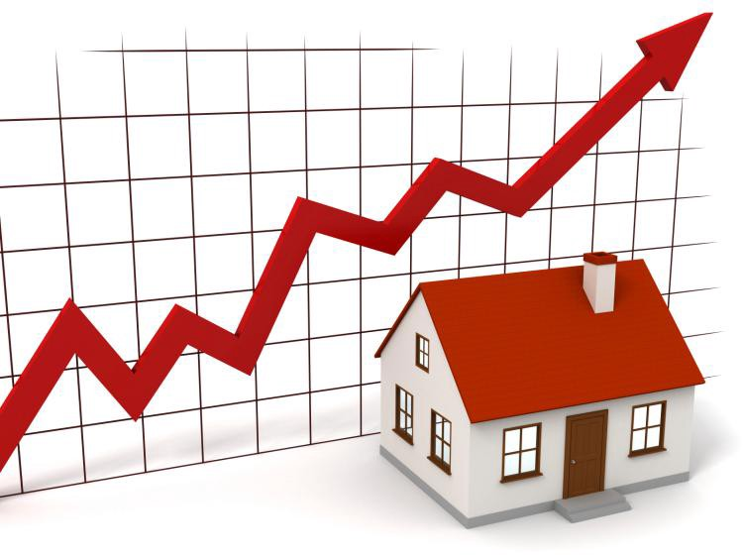
State and Region Based Housing Price Prediction Report
Justin Nichols
Andrew Rodrigue
Zeke Abshire
https://towardsdatascience.com/machine-learning-predicting-house-prices-with-regression-2388bb876a6f
Justin

Slide 2
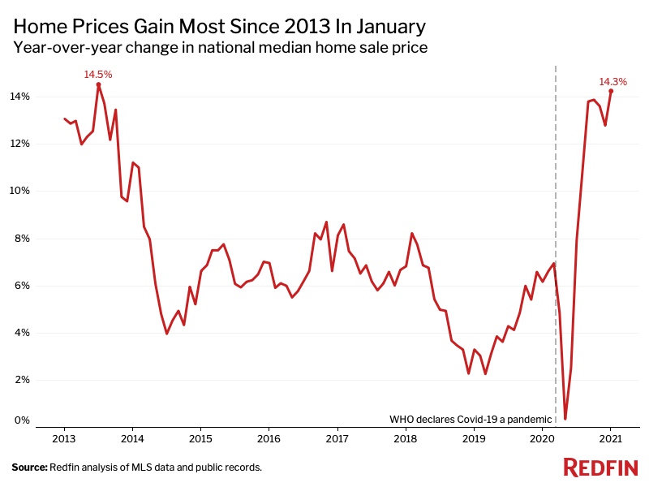
Current Problem
As of late 2021, the house market within the U.S. has become an unlikely beneficiary of the COVID-19 pandemic.
Presently, the housing market is booming, with properties being sold in record time. With this, home prices have climbed at a fast pace.
There is a boost in demand, low mortgage rates, supply is shrinking, and prices are increasing.
https://www.redfin.com/news/coronavirus-pandemic-real-estate-impact-charts/
Justin

Slide 3

Goal and Motivation
The motivating factor behind the development of this housing predictive model was to provide prospective home buyers transparency in housing prices around the country.
https://www.latimes.com/business/story/2021-04-14/real-estate-bidding-wars-hot-market-above-listing-price
Justin

Slide 4
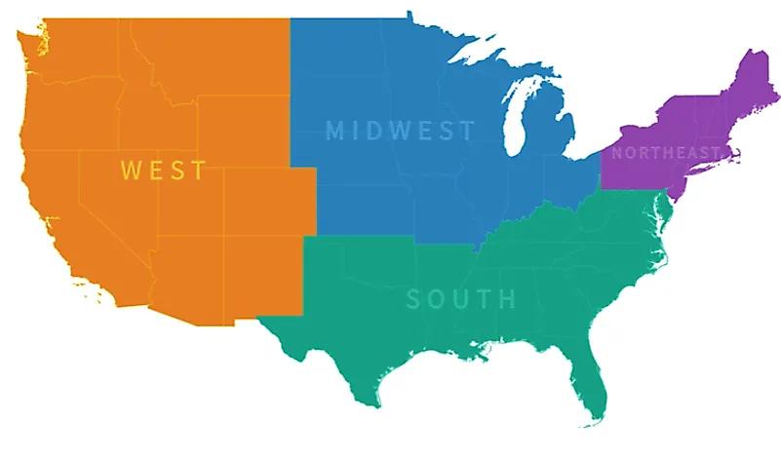
Predictive Models
By providing users the ability to pick a region or state and compare home prices based on their personal information, this model enables them to quickly perform accurate research and make educated decisions on where they want to live.
Models used include KNN and Linear Regression to predict housing prices.
https://www.worldatlas.com/articles/the-regions-of-the-united-states.html
Justin

Slide 5
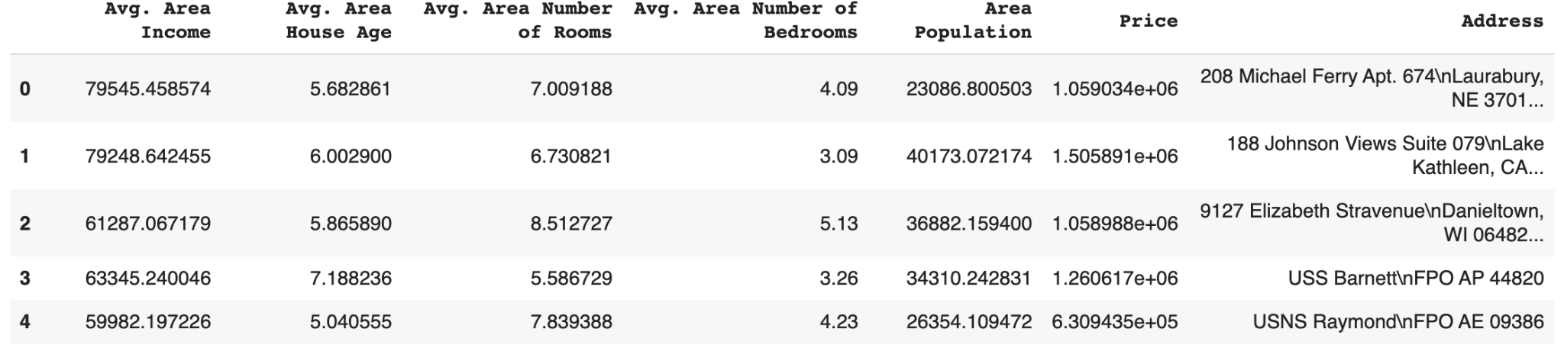
Dataset
The data was obtained from Kaggle.
It is stored in a CSV file format.
There are 5000 total entries.
The attributes are area income, house age, number of rooms, number of bedrooms, area population, price, and address.
Zeke

Slide 6
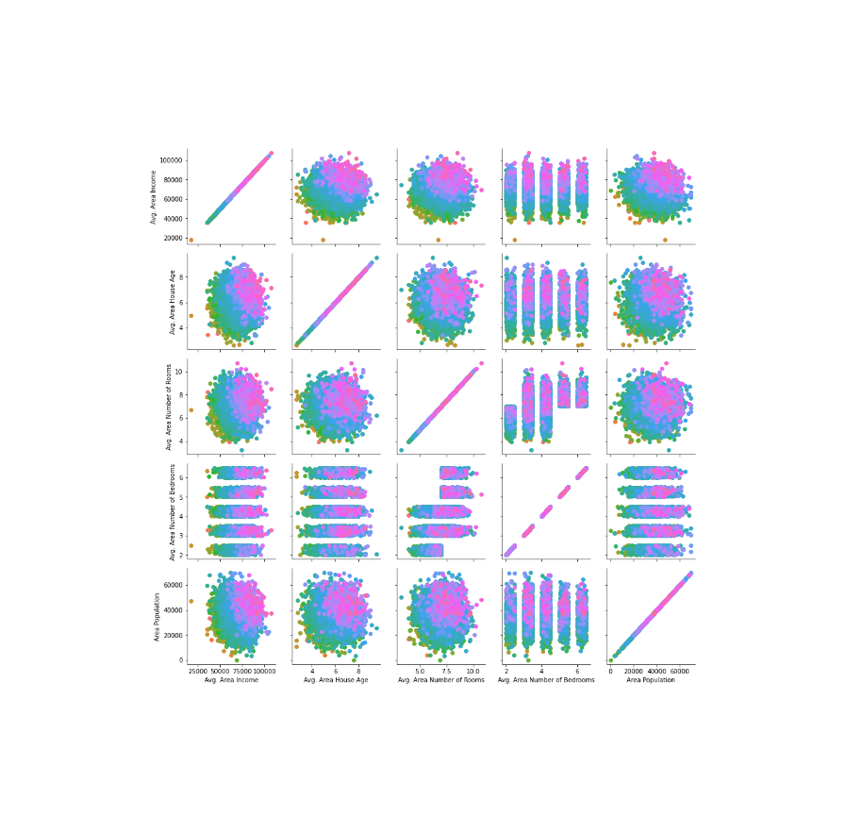
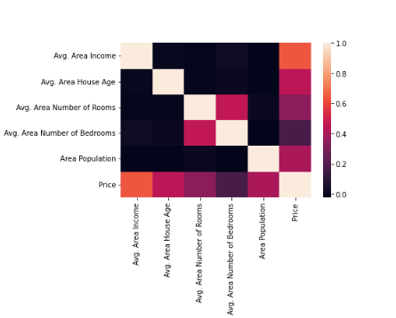
Attribute Correlations
Zeke

Slide 7

KNN
The model divides the relevant entries into price categories of $150,000.
Data is normalized and best value for KFold and KNN is found.
The user inputs their income and desired house age, number of rooms, number of bedrooms, and population of area they are prospecting.
The model outputs a predicted price range using this information.
https://www.analyticsvidhya.com/blog/2018/03/introduction-k-neighbours-algorithm-clustering/
Zeke

Slide 8
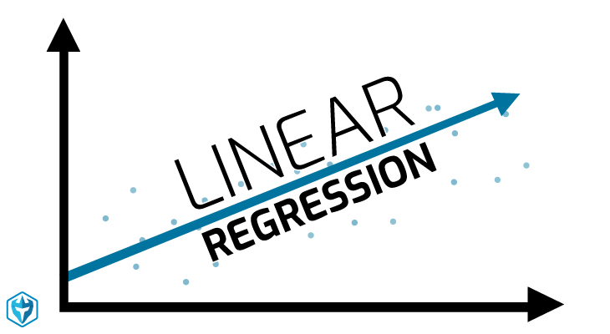
Linear Regression
The user inputs their income and desired house age, number of rooms, number of bedrooms, and population of area they are prospecting.
The model outputs a predicted price range using this information.
https://www.warriortrading.com/linear-regression-definition-day-trading-terminology/
Zeke

Slide 9
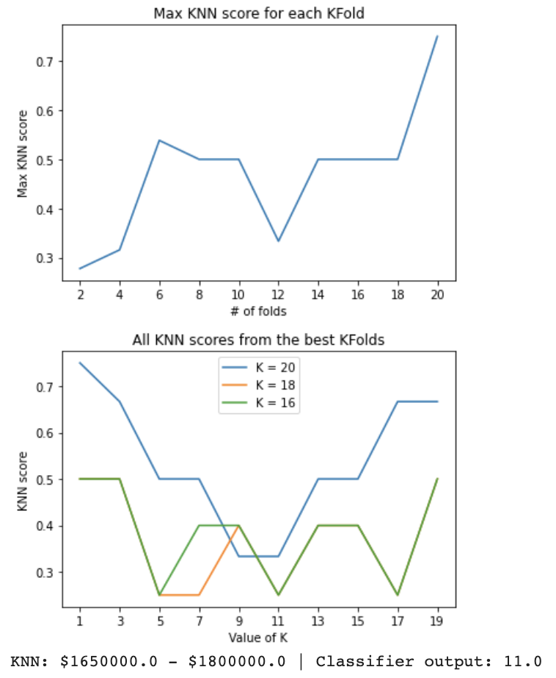
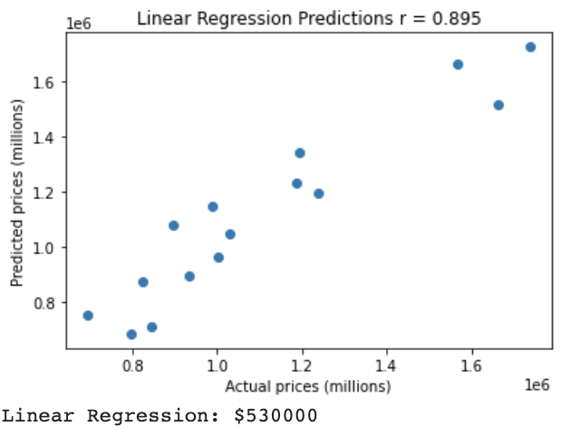
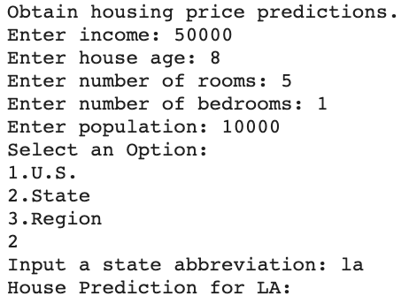
Experiment 1
For Louisiana,
Note, the data used is not based on real prices for the area.
Zeke

Slide 10
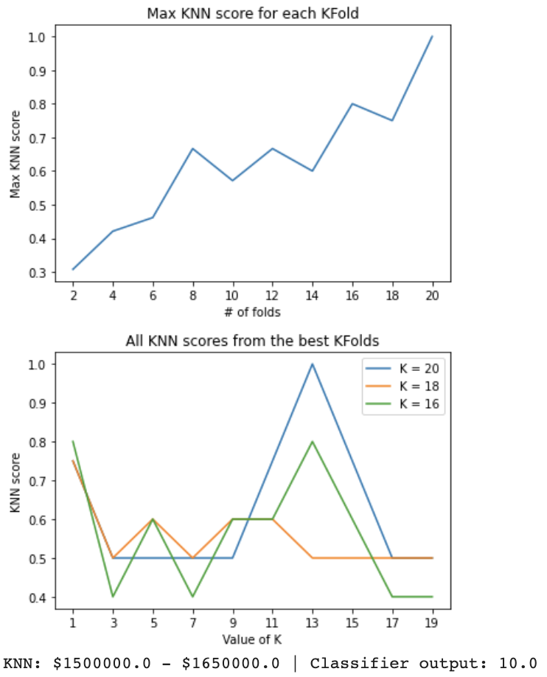
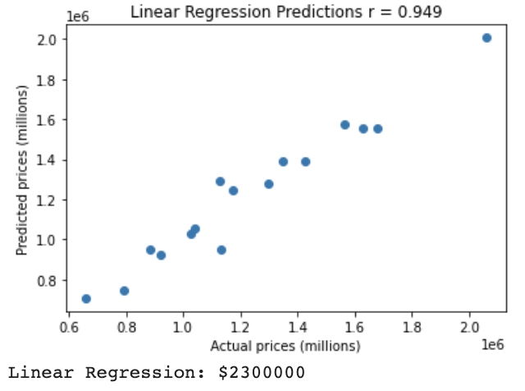
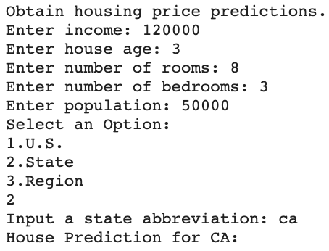
Experiment 2
For California,
Note, the data used is not based on real prices for the area.
Andrew

Slide 11
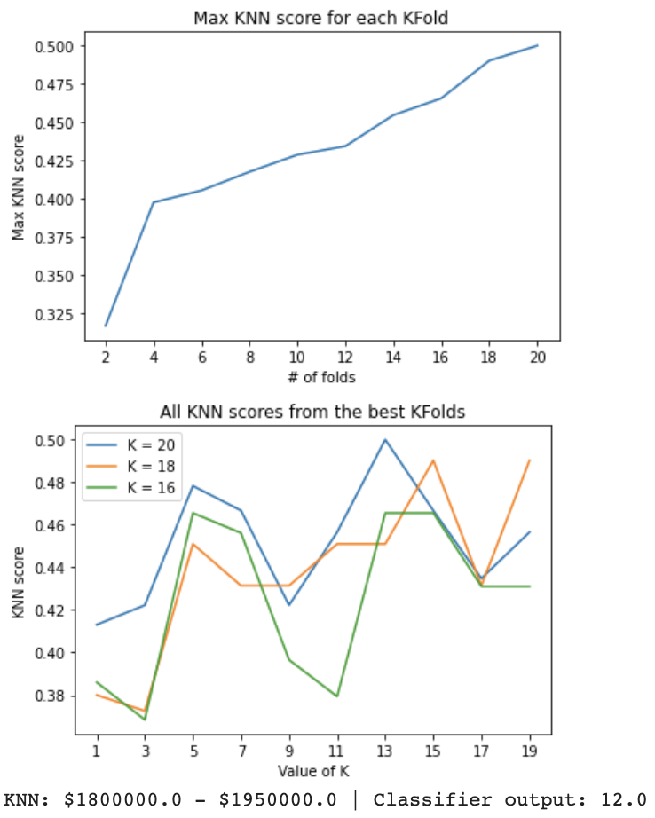
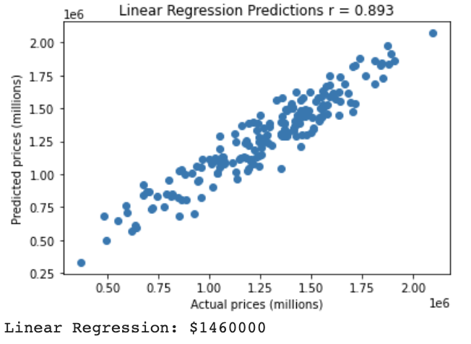
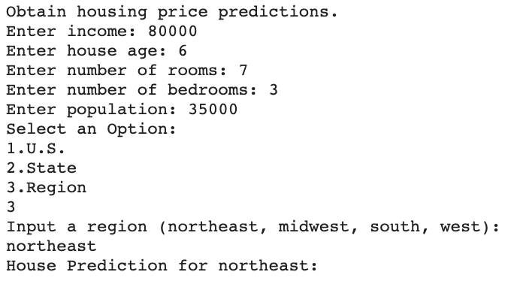
Experiment 3
For Northeast,
Note, the data used is not based on real prices for the area.
Andrew

Slide 12
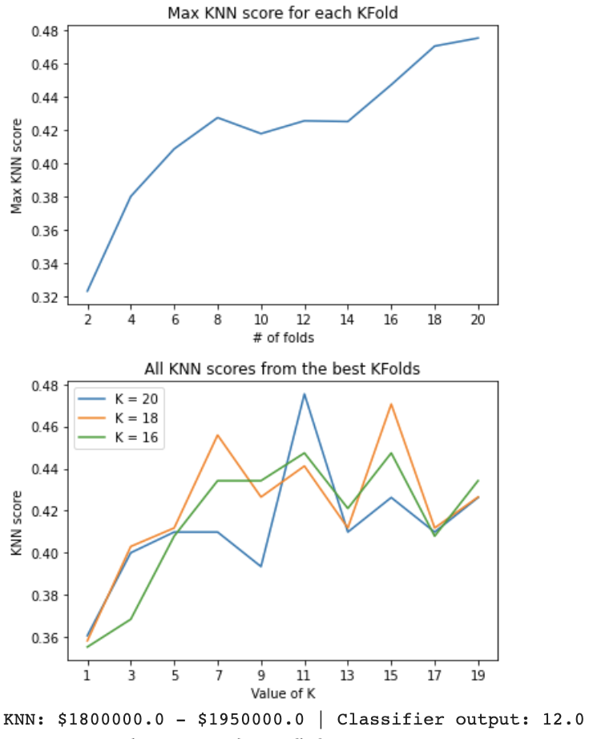
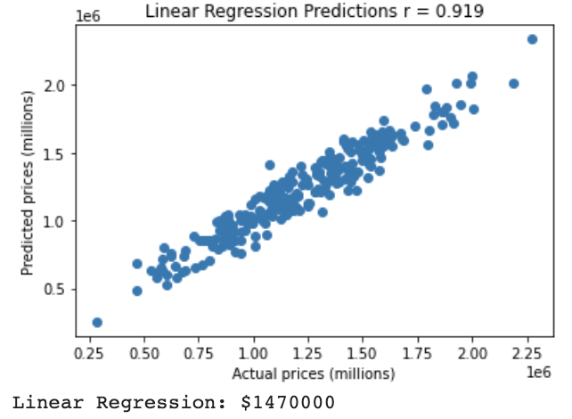
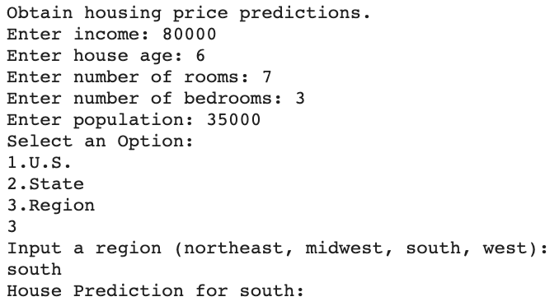
Experiment 4
For South,
Note, the data used is not based on real prices for the area.
Andrew

Slide 13
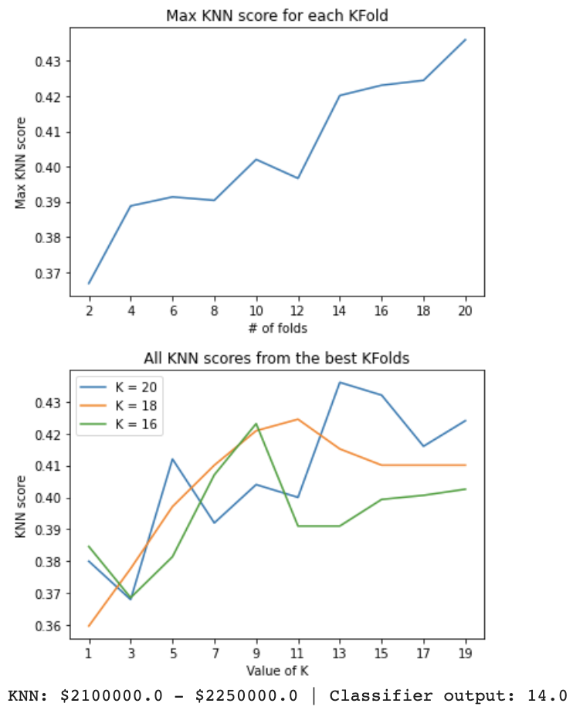
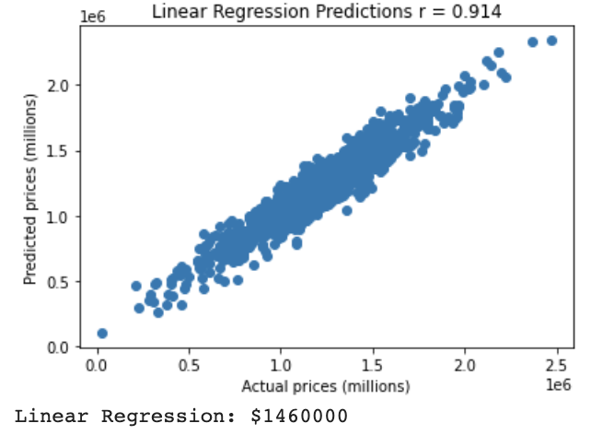
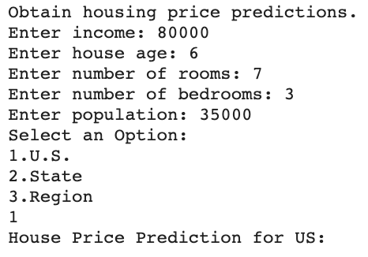
Experiment 5
For U.S.,
Note, the data used is not based on real prices for the area.
Andrew

Slide 14

Conclusions and What We Learned
Linear Regression was found to be more accurate in predicting the housing price for a certain area than KNN.
KNN accuracy: low to mid 40 percent for all experiments.
Linear Regression accuracy: high 80 to low 90 percent for all experiments.
The insights made from the experiments helped
our group to conclude that some states or regions
have on average higher home prices.
Andrew

